Slide 1
Ontology for Discoverable and Interoperable Radiology AI Models and Datasets
Charles Kahn, Abhinav Suri, Safwan Halabi, Hari Trivedi

Slide 2
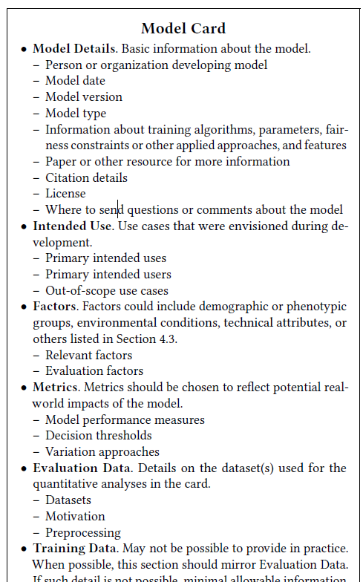
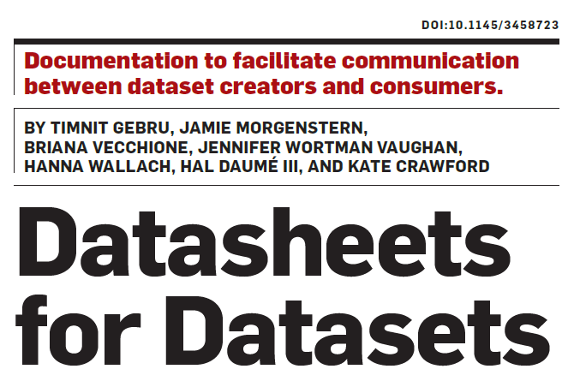
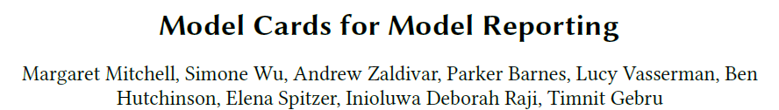
DOI: 10.1145/3287560.3287596

Slide 3
Goals
Promote reproducibility of trained AI models
Identify and mitigate potential biases
Support FAIR guiding principles
(Findable, Accessible, Interoperable, Reusable)
Help users assess AI tools and datasets for practice or research

Slide 4
Radiology Model and Dataset Ontology
Standardized terminology
AI models
Datasets
Ontology
JSON document schema

Slide 5
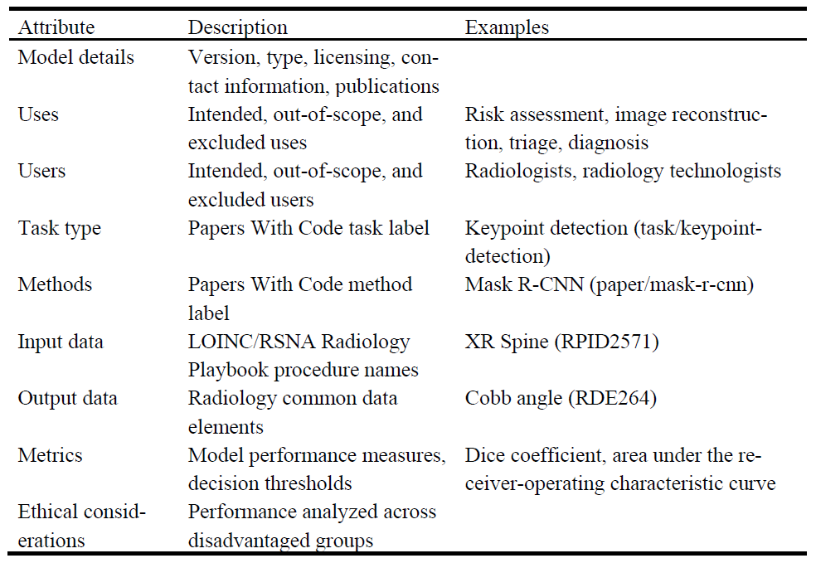
Model descriptors

Slide 6
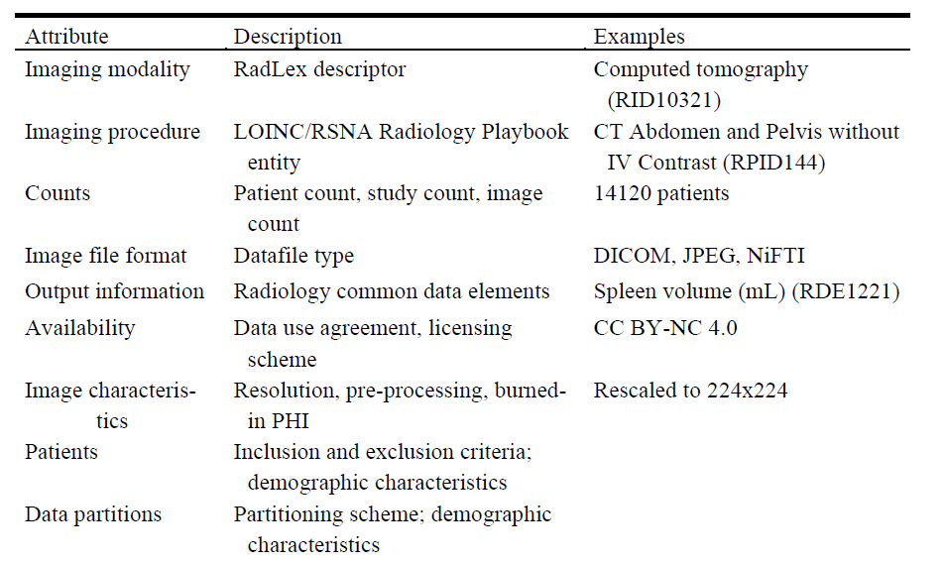
Dataset descriptors

Slide 7
Ontology
Human-readable and machine-computable description of domain
Defines formal attributes and allowable values
Links to ontologies and reference sources
RadLex
LOINC / RSNA Radiology Playbook
Radiology Common Data Elements (CDEs)
PapersWithCode.com

Slide 8
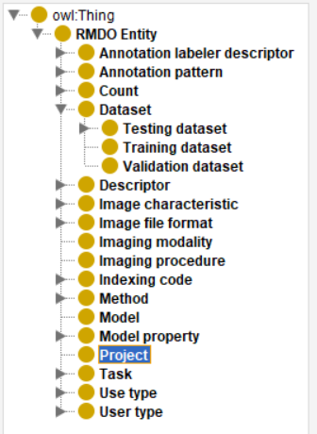
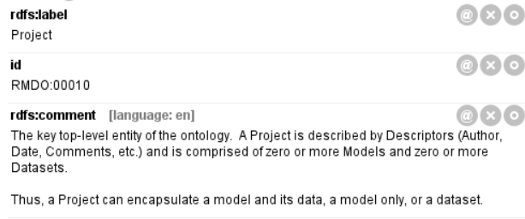

Slide 9
RMDO
3,323 classes
RMDO Entity = top-level entity
4,403 logical axioms
Project
Metadata: authors, versioning, availability, licensing, and other features
Model(s)
Dataset(s)

Slide 10
JSON Document Schema
Project
Models (0 or more)
Datasets (0 or more)
Follows structure of ontology
Uses ontology’s terms and reference pointers

Slide 11
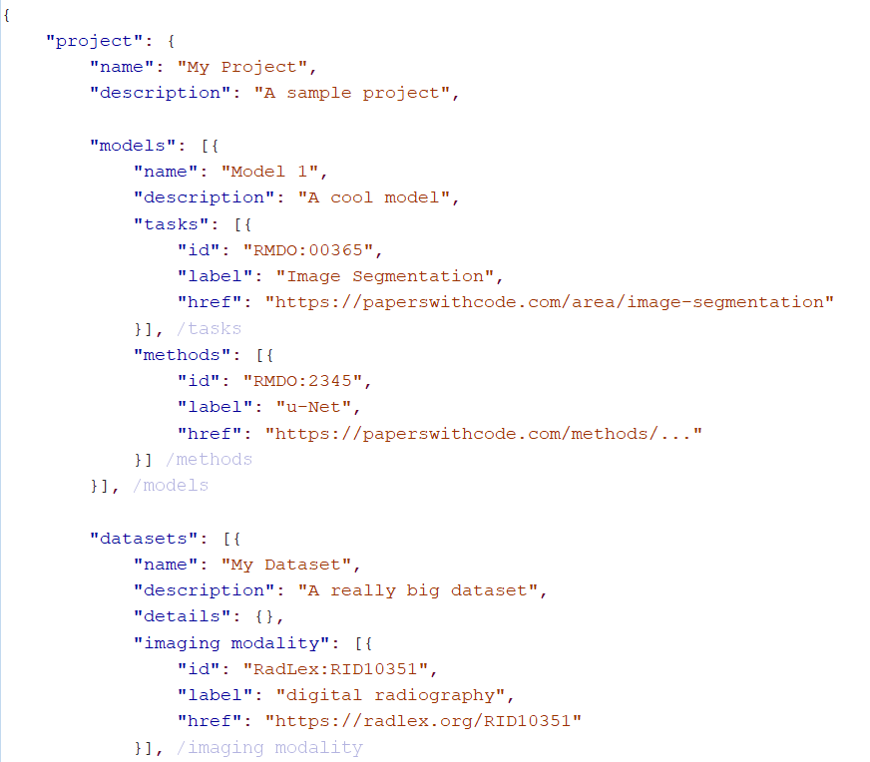
Project
Model
Dataset

Slide 12
Applications
AI models from RSNA AI Challenges
Datasets published for RSNA’s AI competitions
Active development
RSNA Radiology AI Data Standards (RAIDS) Committee

Slide 13

Thank you !
github.com/cekahn/RMDO
ckahn@upenn.edu

